Slide 1
Citi Bike Data Analysis
By Sai Sravanthi Kilari

Slide 2
Project Goal:
To better understand the behavior of Citi Bike’s customer base (both one-time users and subscribers) and how they use Citi Bikes
This will help us to:
Identify where more bikes should be installed
Create targeted marketing campaigns that will appeal to different customer segments

Slide 3
Key questions:
What are the most popular pick-up locations across the city for Citi Bike rental?
How does the average trip duration vary across different age groups?
Which age group rents the most bikes?
How does bike rental vary across the two user groups (one-time users vs long-term subscribers) on different days of the week?
Does the factor of user age impact the average bike trip duration?

Slide 4
Findings & Insights

Slide 5
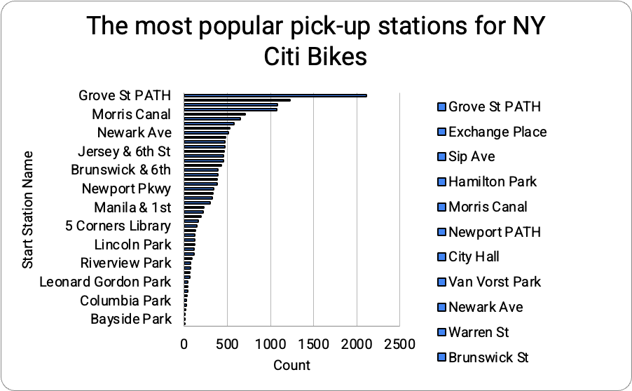
What are the most popular Citi Bike pick-up locations?

Slide 6
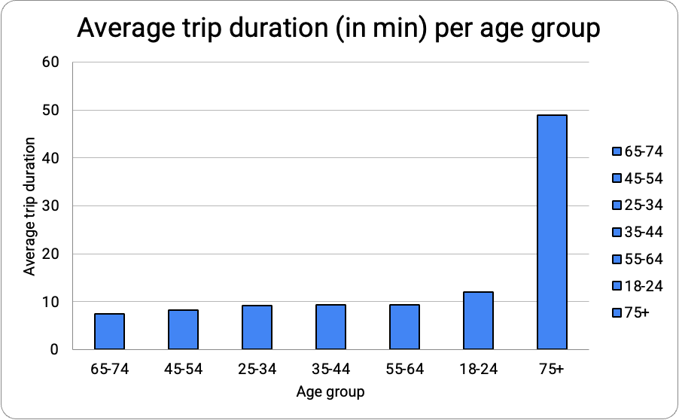
2. How does the average trip duration vary across different age groups?
Age group 75+ take longest avg trip duration while
Age group 65-74 take the shortest duration.

Slide 7
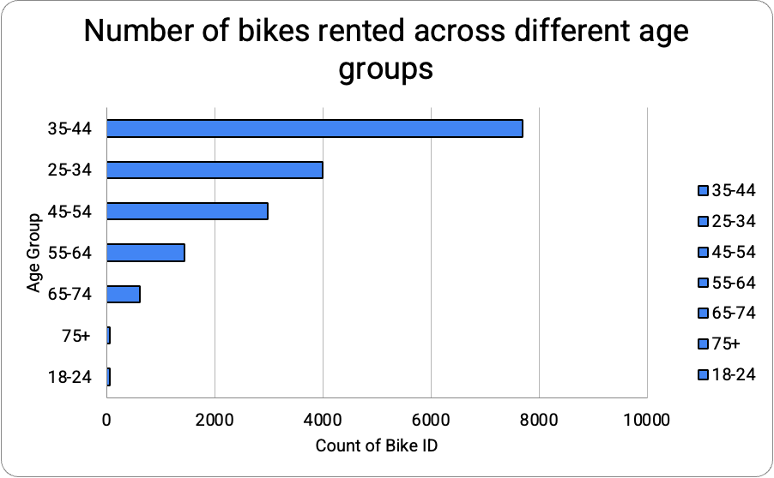
3. Which age group rents the most bikes?
Age group 35-44 rents the highest number of bikes.

Slide 8
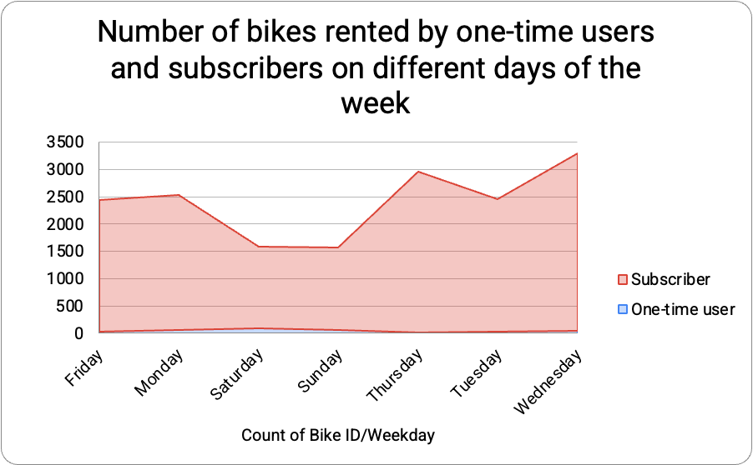
4. How does bike rental vary across the two user groups (one-time users vs long-term subscribers) on different days of the week?
Most Citi Bike users are regular, loyal subscribers rather than one-time users.

Slide 9
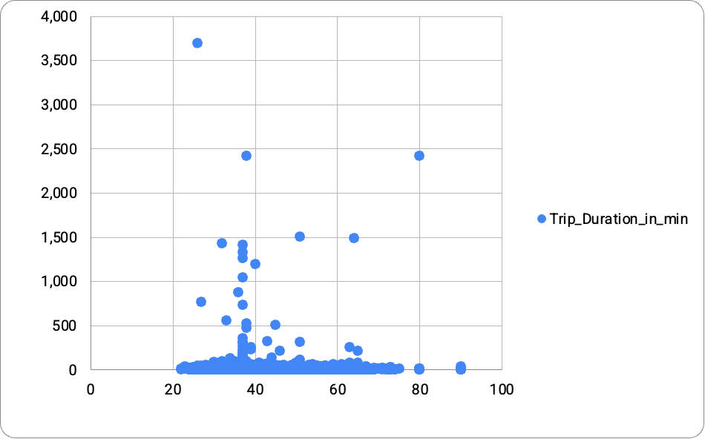
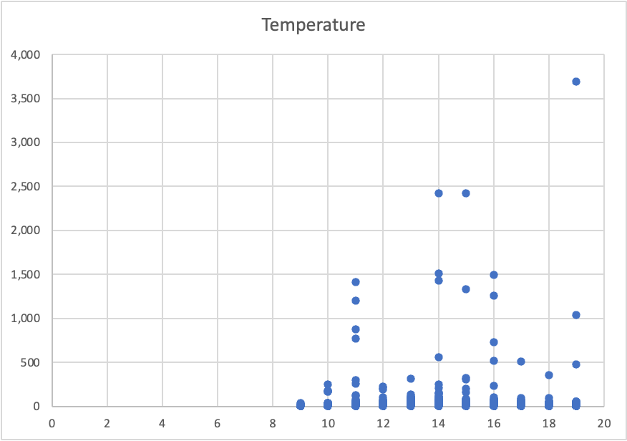
5. Do factors like weather and age impact the average bike trip duration?
Age and Weather does not have much correlation with avg bike trip duration.

Slide 10
Summary

Slide 11
Summary of findings:
Top 5 pick-up locations for bikes:
Grove St Path, Exchange Place, Sip Ave, Hamilton Park, & Morris Canal
Customer base:
Age group 35-44 year rented most bikes and most citi bike users are regular loyal lon-term subscribers rather than one-time users.
Citi Bike customer behavior:
Longest trips are taken by age group 75+ while shortest trips are taken by age group 65-74.

Slide 12
Actions & Recommendations

Slide 13
Recommended actions:
Product recommendations:
Install more bikes at Grove St Path, Exchange Place, Sip Ave, Hamilton Park, & Morris Canal locations.
Marketing recommendations:
The Citi Bike customer base is mostly long term users...aged between 35-44 years who are most active on weekdays. This tells us that they are probably people who live in New York and use Citi Bikes to commute. Marketing and advertising campaigns should therefore target this particular demographic.

Slide 14
Thank you!

